Slide 1



Voices from the Field: Strengthening Teacher Prep through Collaborative Insight
-Helen Berg
-Ashley Brittain
-Alycia Maurer
-Apolonio Trejo
-Valerie A. Martinez
-Kelli Allen
-Pamela Elias
-Carrie Culpepper
-Angie Taylor
-Kristina Vargo
EPPIC Convening SP2026 | April 16

Slide 2
Presentation Highlights
Collaboration among three diverse university education preparation programs
Employed improvement science to examine stakeholder perceptions of teacher candidate preparedness.
PDSA cycles
  Revised the TEA Principal Survey and First-year Teacher Survey
  Gathered data from candidates and mentor/host teachers
  Focus on perceptions of preparedness in core instructional domains:
    Planning,
    Instructional Practices (including feedback, assessment, questioning, and data-driven decisions),
    Classroom Environment, and
    Differentiation.
Findings informed the development of a shared toolkit of instructional supports, designed for integration into coursework and clinical field experiences

Slide 3
Current challenges in teacher preparation demand urgent attention and collaborative innovation. Among the most pressing issues are:
The need to clearly define what constitutes high-quality teacher preparation.
Significant variation in perceptions of candidate preparedness between teacher candidates and cooperating teachers.
Potential disconnects between coursework and the authentic expectations of classroom practice, which can lead to misalignment in perceived preparedness.

Slide 4
Purpose of the Study
Examine stakeholder perspectives across our three universities on teacher candidate preparedness in:
Planning
Instructional Practices
Classroom Environment
Differentiation

Slide 5

Research Question
How do stakeholders perceive teacher candidate preparedness in the core methods: Planning,
Instructional Practices, Classroom Environment, and Differentiation?
With Instructional Practices including: Academic Feedback, Assessment, Questioning, Data Driven Decisions

Slide 6
Study Design and Methods
Type: Conducted multi-stakeholder program evaluation
Approach: Multi-stakeholder survey design.
Participants: Teacher candidates (n=95) and cooperating teachers (n=89)
Data Collection:
  Likert-scale survey questions
  One open-ended item for improvement suggestions
Data Analysis:
  Descriptive statistics + thematic coding for qualitative responses

Slide 7
1. How effectively do you design clear, well-organized, and sequential lessons that align with state content standards?
(Aligned with Dimension 1.1: Standards and Alignment)
Candidate Survey
Improvement Needed: 2%
Developing: 14%
Proficient: 67%
Accomplished: 17%
Cooperating Teacher Survey
Improvement Needed: 0%
Developing: 27%
Proficient: 52%
Accomplished: 21%

Slide 8
2. How effectively do you incorporate engaging, flexible activities to encourage higher-order thinking?
(Aligned with Dimensions 1.1 and 1.4)
Candidate Survey
Improvement Needed: 5%
Developing: 21%
Proficient: 60%
Accomplished: 14%
Cooperating Teacher Survey
Improvement Needed: 7%
Developing: 29%
Proficient: 50%
Accomplished: 14%

Slide 9
3. To what extent do you demonstrate knowledge of students' prior knowledge, experiences, and learning needs by planning lessons with activities and materials that are relevant and appropriate?
(Aligned with Dimensions 1.3 and 1.4)
Candidate Survey
Improvement Needed: 2%
Developing: 14%
Proficient: 57%
Accomplished: 26%
Cooperating Teacher Survey
Improvement Needed: 5%
Developing: 32%
Proficient: 50%
Accomplished: 13%

Slide 10
7. How effectively do you establish and implement clear classroom routines and procedures that create a safe, accessible, and organized environment for student learning?
(Aligned with Dimension 3.1: Classroom Environment, Routines, and Procedures)
Candidate Survey
Improvement Needed: 2%
Developing: 7%
Proficient: 69%
Accomplished: 21%
Cooperating Teacher Survey
Improvement Needed: 4%
Developing: 14%
Proficient: 28%
Accomplished: 21%

Slide 11
4. How effectively do you use formal and informal assessments to measure student progress and inform instructional planning?
(Aligned with Dimension 1.2: Data and Assessment)
Candidate Survey
Improvement Needed: 5%
Developing: 19%
Proficient: 57%
Accomplished: 19%
Cooperating Teacher Survey
Improvement Needed: 2%
Developing: 29%
Proficient: 48%
Accomplished: 21%

Slide 12
5. To what extent do you provide specific, timely, and actionable feedback to students to support student growth and achievement?
(Aligned with Dimension 1.2: Data and Assessment)
Candidate Survey
Improvement Needed: 4%
Developing: 23%
Proficient: 46%
Accomplished: 27%
Cooperating Teacher Survey
Improvement Needed: 5%
Developing: 19%
Proficient: 57%
Accomplished: 19%

Slide 13
6. How effectively do you use clear and accurate communication, including questioning techniques, to engage students in deeper learning and meaningful discussions?
(Aligned with Dimension 2.3: Communication)
Candidate Survey
Improvement Needed: 2%
Developing: 26%
Proficient: 50%
Accomplished: 21%
Cooperating Teacher Survey
Improvement Needed: 4%
Developing: 25%
Proficient: 54%
Accomplished: 18%

Slide 14
8. To what extent do you promote a respectful and collaborative classroom culture by managing student behavior effectively and fostering positive student interactions?
(Aligned with Dimensions 3.2: Managing Student Behavior and 3.3: Classroom Culture)
Candidate Survey
Improvement Needed: 2%
Developing: 7%
Proficient: 63%
Accomplished: 27%
Cooperating Teacher Survey
Improvement Needed: 0%
Developing: 23%
Proficient: 39%
Accomplished: 36%

Slide 15
9. How effectively do you adapt instruction using differentiated methods, materials, and strategies to support deeper learning and effective effort?
(Aligned with Dimension 2.3: Communication and 2.4: Differentiation)
Candidate Survey
Improvement Needed: 2%
Developing: 29%
Proficient: 50%
Accomplished: 19%
Cooperating Teacher Survey
Improvement Needed: 4%
Developing: 43%
Proficient: 39%
Accomplished: 14%

Slide 16
10. As a teacher candidate, what do you perceive as the most significant area of growth for (enter university name)’s preparation program in preparing teacher candidates to excel in planning, instructional practices, classroom environment, and differentiation? Please provide specific examples or suggestions for improvement in these areas.
“Personally, I see the area of an earlier classroom management course as something that could be beneficial. I know that classroom management is learned more whilst in the classroom, but maybe a module in an earlier course, or some more training on it earlier in the program would be beneficial.”
“I would love more support in differentiation, what it is, and what it looks like.”
“Using data to drive instruction.”

Slide 17
10. As a cooperating teacher, what do you perceive as the most significant area of growth for (enter university name)’s preparation program in preparing teacher candidates to excel in planning, instructional practices, classroom environment, and differentiation? Please provide specific examples or suggestions for improvement in these areas.
“As with all new teachers, I've found that effective classroom management requires practice. I believe that drawing from established teaching methods can greatly enhance our approach.
In my experience with Teacher Residents, I've noticed that they often come equipped with extensive technology knowledge but may lack traditional teaching methods.”
“In summary, while the educator preparation program provides a solid foundation, placing more emphasis on technology integration, trauma-informed practices, and differentiated instruction would further empower future educators to meet the diverse needs of their students. While teacher candidates learn from their cooperating teachers, the current program offers a generic list of goals that all candidates are expected to achieve by the end of their clinical year. More tailored, individualized goals could better address the unique strengths and challenges of each candidate.”
“Utilizing more of the PLC process that campuses use and observing more of the collaboration among teachers within teams that impacts more students’ development and success.”

Slide 18
Strengths Identified by both Stakeholder Groups:
Foundational Planning
Strong lesson design aligned to standards
Clear objectives and sequencing
Majority rated Proficient or Accomplished
Professional Disposition
Reliability and responsibility
Respectful relationships
Positive collaboration with mentor teachers
Classroom Structure (Emerging Strength)
Candidates report strong routine implementation
Cooperating teachers acknowledge foundational management skills

Slide 19
Areas for Growth Identified by Both Groups
Differentiation (Strongest Shared Concern)
High “Developing” ratings from cooperating teachers
Candidates requested more support and clarity
Need for practical differentiation strategies
Data-Driven Instruction
Gap between candidate self-perception and mentor evaluation
Need stronger use of assessment to inform instruction
Limited PLC exposure and applied data analysis
Classroom Environment (Perception Gap)
Candidates rated themselves highly
Cooperating teachers indicated more “Developing” performance
Emphasis on practice-based classroom management

Slide 20
Outcomes and Impact
Shared Understandings:
We responded to contextual variation by developing common definitions and expectations for teacher preparedness across our programs.
Increased Collaboration:
The partnership fostered deeper collaboration among faculty and staff across institutions, enabling shared investigations and solutions.
Program Improvements:
Survey data informed targeted improvements in coursework and field experiences, ensuring that candidates are better prepared for classroom realities.
Institutionalization of Supports:
Resources and tools developed through this process are now embedded in our programs, providing sustained support for candidates in areas of need.
Teacher Candidate Development Toolkit:
Co-created Toolkit designed to support teacher candidates, that includes resources for teacher candidates and support their development in instructional planning using data driven instructional resources, strategies for quality differentiation and resources for fostering a positive classroom environment

Slide 21

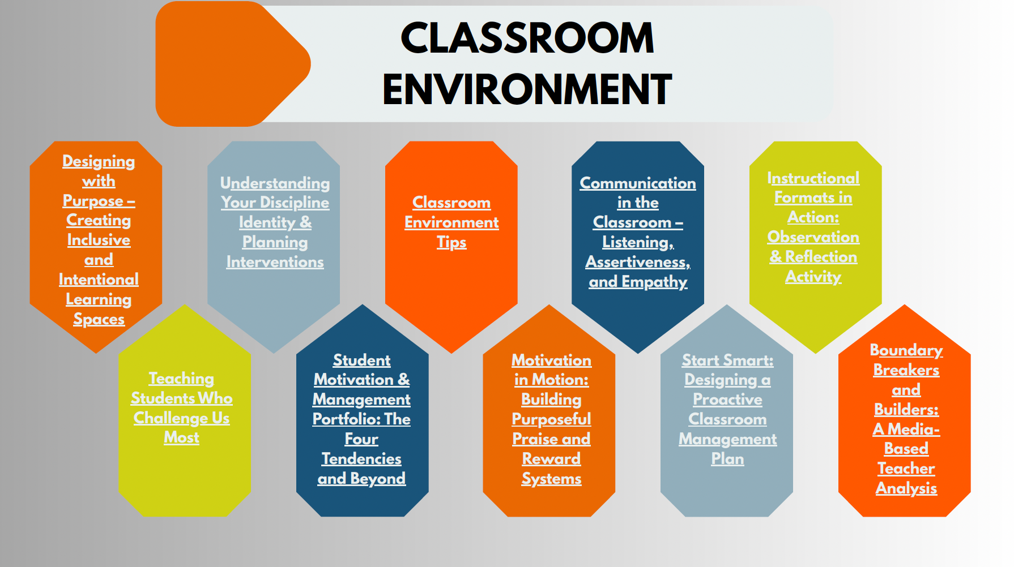
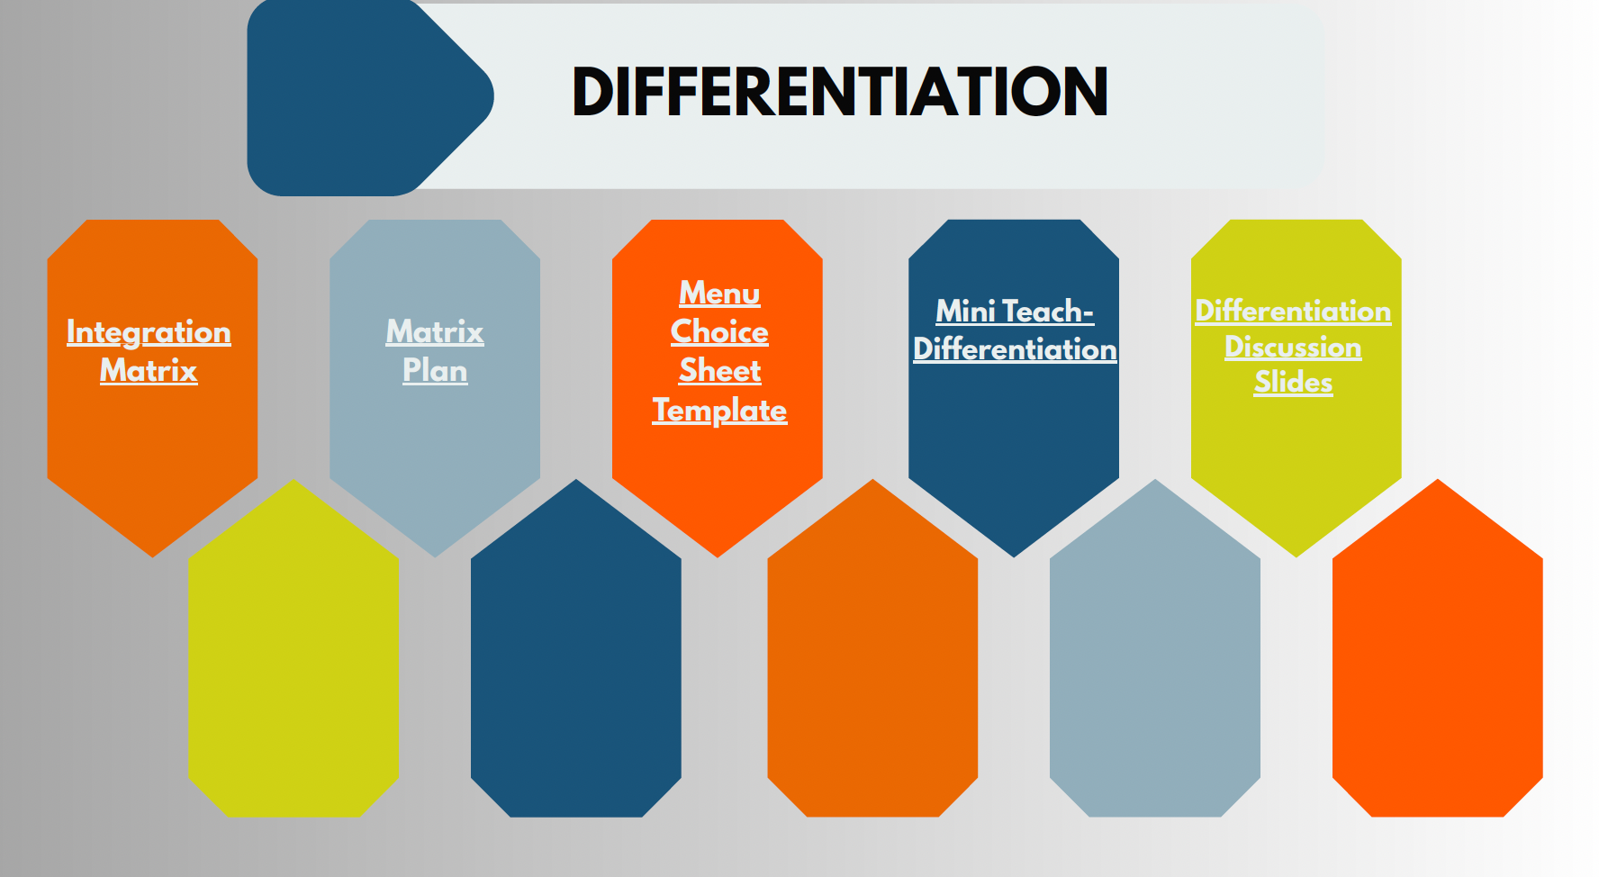
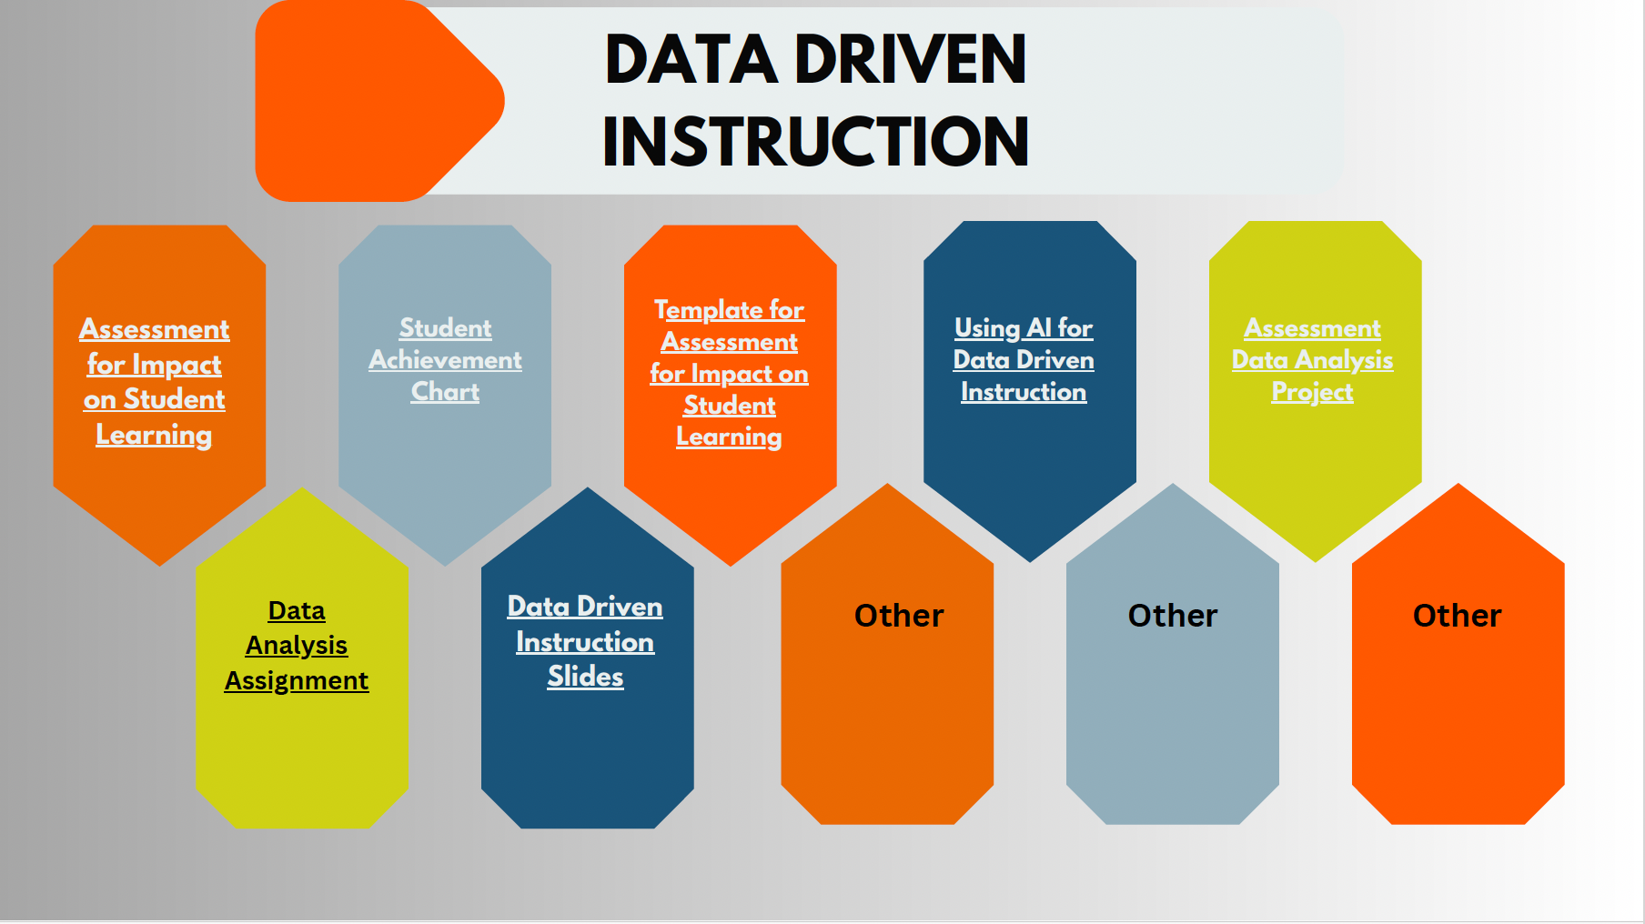

Slide 22
Discussion
Where Do You See This?
At your table, discuss:
Where do perception gaps show up in your program?
Which domain is hardest to align between faculty and mentors?

Slide 23
Discussion
Residency as Amplifier?
At your table, discuss:
Does extended clinical time reduce gaps — or reveal them?
What has your residency model made visible?

Slide 24
Discussion
From Data to Design
At your table, discuss:
How are you currently using stakeholder data?
What prevents programs from acting on what they learn?

Slide 25
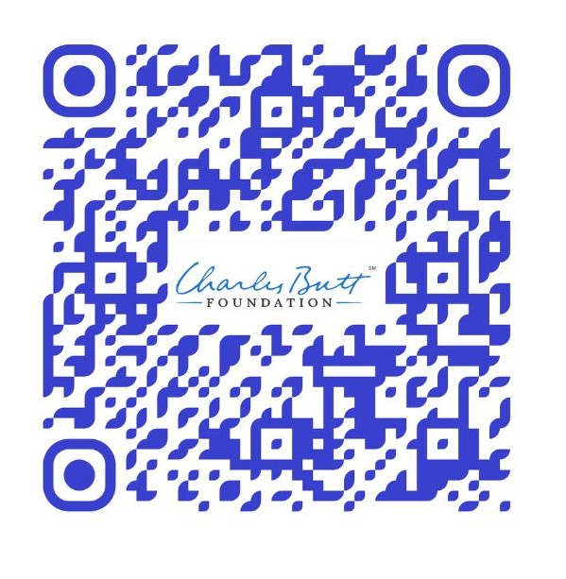
Thank You!
Click here or scan the QR code to access our canva toolkit

