Slide 1
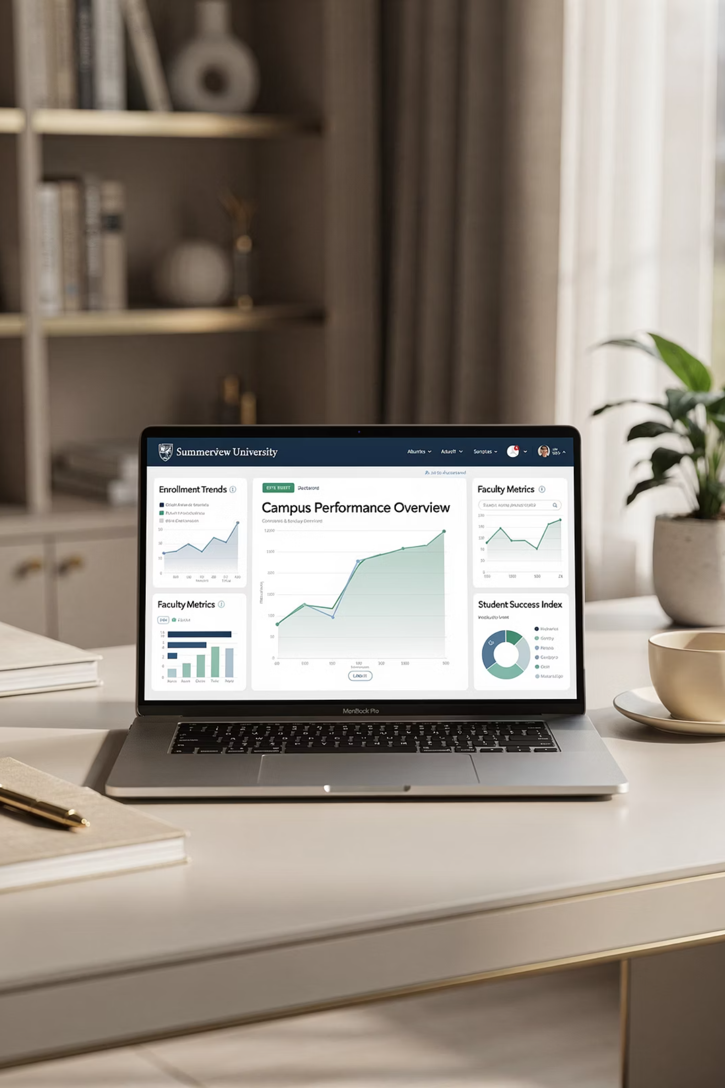
Data Systems & Instructional Improvement
A collaborative EPPIC inquiry across TAMUT, UTEP, Tarleton, and West Texas A&M University — exploring how four educator preparation programs tackled inefficiencies in data collection, entry, and analysis to improve faculty workload and enable timely instructional decisions.
EPPIC COLLABORATIVE
Spring 2026

Slide 2
Why This Work Matters
Across all four institutions, a shared problem emerged: data existed, but wasn't usable in real time. A faculty survey at West Texas found many current data processes labeled "Unknown" or "Needs Improvement" — a signal that urgency was real.
TAMUT
UTEP
Data collected but not easily translated into actionable insights for instructors.
Needed to better connect with paraprofessionals and instructional aides to increase enrollment in high-needs certification areas.
Tarleton
West Texas A&M University (WTAMU)
Disparate survey and assessment methods created a need for centralized, standardized processes.
Data existed for reporting but wasn't returned fast enough to influence course improvements; reliance on a single IT contact created institutional memory risk.

Slide 3

Tests of Change: What Each Campus Tried
TAMUT
Automated workflow connecting Microsoft Forms to Power BI dashboards to monitor SLOs in real time across ED 486, 487, and 490.
UTEP
Direct presentations to paraprofessionals for recruitment; redesigned the POP packet to streamline data entry for site coordinators.
Tarleton
Phased rollout of the TSU Educator Portal using a Portal Committee and small-scale pilot groups (Blocks 1 and 2) to refine forms and protocols.
West Texas
Qualtrics needs assessment with faculty/staff; began transition to the Aggie Portal to automate exam breakdown distribution and feedback.

Slide 4
Learning Across the Team
How Thinking Evolved
How Campuses Influenced Each Other
UTEP's focus on simplifying data entry at the point of collection shaped TAMUT's thinking about clean inputs. Tarleton and West Texas's movement toward the Aggie Portal provided a roadmap for integrating institutional data into state-level reporting structures.
Over time, the team shifted from isolated solutions to considering the full data lifecycle: collection, entry, analysis, visualization, and use. Key insights included:
Sophisticated systems still require strong user support (TAMUT)
Direct stakeholder engagement is essential (UTEP)
Slow-release pilots catch form errors early (Tarleton)
Faculty need to know "the why" to buy in (West Texas)
Collaborative sessions — including the Fall 2025 CSOTTE conference — allowed the EPPIC to refine approaches and consider solutions beyond individual campuses.

Slide 5
Evidence Collected & What It Revealed
TAMUT
UTEP
System performance logs, instructor reflections, and dashboard usage data.
Recruitment attendance, application numbers, and site coordinator feedback on the POP packet.
Tarleton
West Texas
Portal completion rates, Zoom focus group transcriptions, and form refinement logs.
21 Qualtrics responses from faculty and staff assessing current system functionality.
What Worked
What Didn't
Streamlining systems — through automation or simplification — improved both efficiency and user experience. A single "source of truth" improved usability across all contexts.
Technical complexity (TAMUT), document access issues (UTEP), anonymity vs. qualitative feedback tension (West Texas), and "portal fatigue" without a clear handbook (Tarleton).

Slide 6
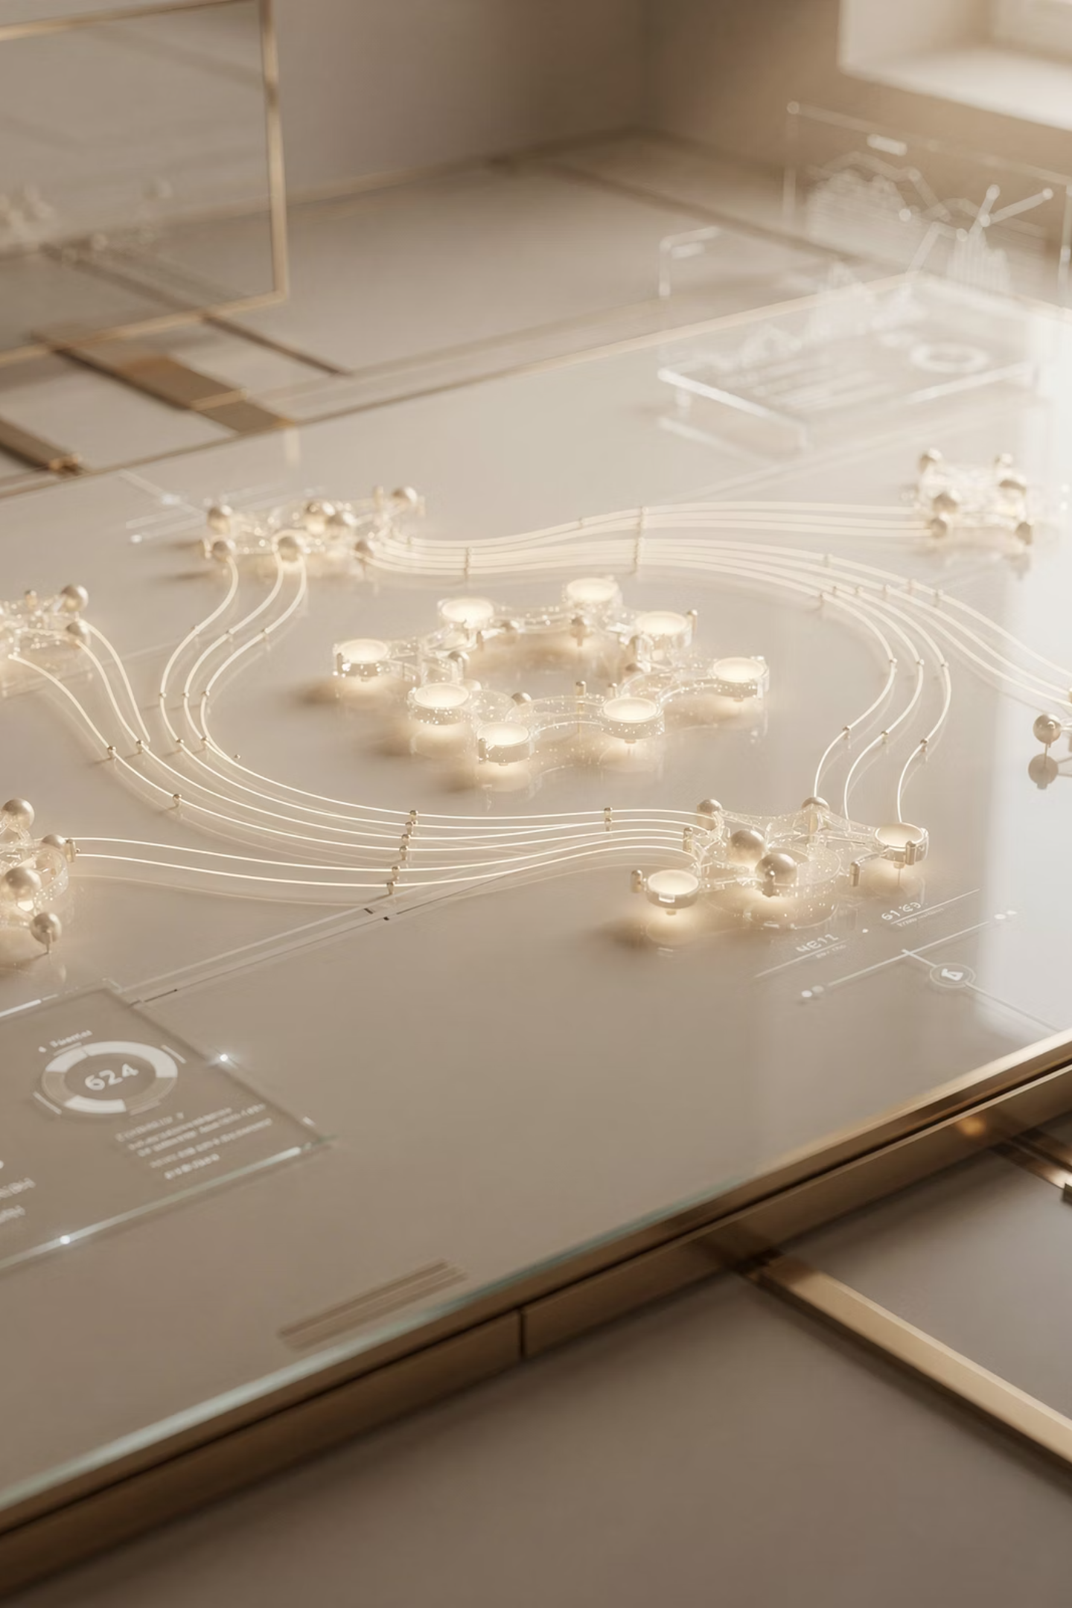
A Consistent Pattern: The "One-Stop Shop"
All campuses expressed the need for a single place where data could be accessed, interpreted, and used by multiple stakeholders.
TAMUT
Power BI dashboard as a real-time visualization hub for SLO monitoring.
UTEP
Streamlined POP packet reducing redundancy at the point of data collection.
Tarleton & West Texas
Standardized Educator/Aggie Portal providing consistent data access across stakeholders.

Slide 7


Implications & Cautions for the Field
What Programs Should Try
What to Approach with Caution
Simplify data collection before moving to advanced systems
Create "Pilot Quick-Start Guides" (Tarleton model)
Conduct internal needs assessments to ensure the system solves actual faculty problems (West Texas model)
Avoid complex tech solutions without a plan for staff turnover or ongoing training
A system is only as good as the person currently running it — build in redundancy
Improving data systems is an organizational challenge as much as a technical one
Success requires alignment from the Dean to the Student Worker
Effective data systems must be both functional and usable. The goal is not just to collect data — but to ensure it improves outcomes.
West Texas: without clear software procedures, institutional memory is at risk during staff transitions.

Slide 8

Next Steps & Looking Ahead
Each institution leaves this EPPIC cycle with clear momentum. The work reinforces that improvement efforts must center human-centered data design — prioritizing clarity, accessibility, and the removal of "technical walls."
TAMUT
Tarleton
Scale the Power BI dashboard system and connect to Banner data.
Full portal launch for Blocks 1–4 and an April 2026 Spring Convening.
1
2
3
4
UTEP
West Texas A&M University (WTAMU)
The new data system has enhanced documentation and data collection in our program. By the academic year 2026-2027, new data will be shared across the region.
Full Educator Portal rollout in Spring 2026 and portal use processes established.
The shared takeaway: data must not only be collected — it must be returned to the people who need it, in a form they can act on, in time to make a difference.

Slide 9
