Slide 1
Developing Consistency in Supporting Mentor Teachers
University of Texas at Dallas- UTeach Dallas
Rice University
University of the Incarnate Word

Slide 2
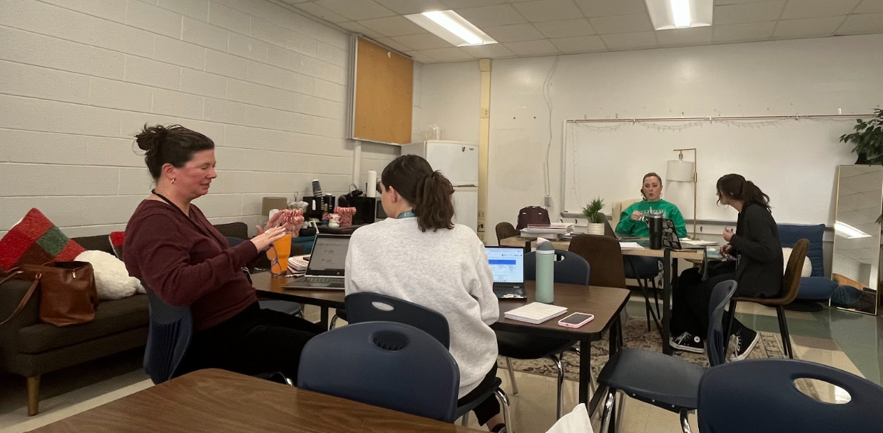
Focus Statements
Statement 1: EPPs do not have a consistent and effective support structure for mentor teachers.
Statement 2: There is a lack of consistency in the way mentor teachers support/coach teachers.

Slide 3

[Focus Statements]
EPPs do not have a consistent and effective support structure for mentor teachers.
There is a lack of consistency in the way mentor teachers support and coach teachers.

Slide 4
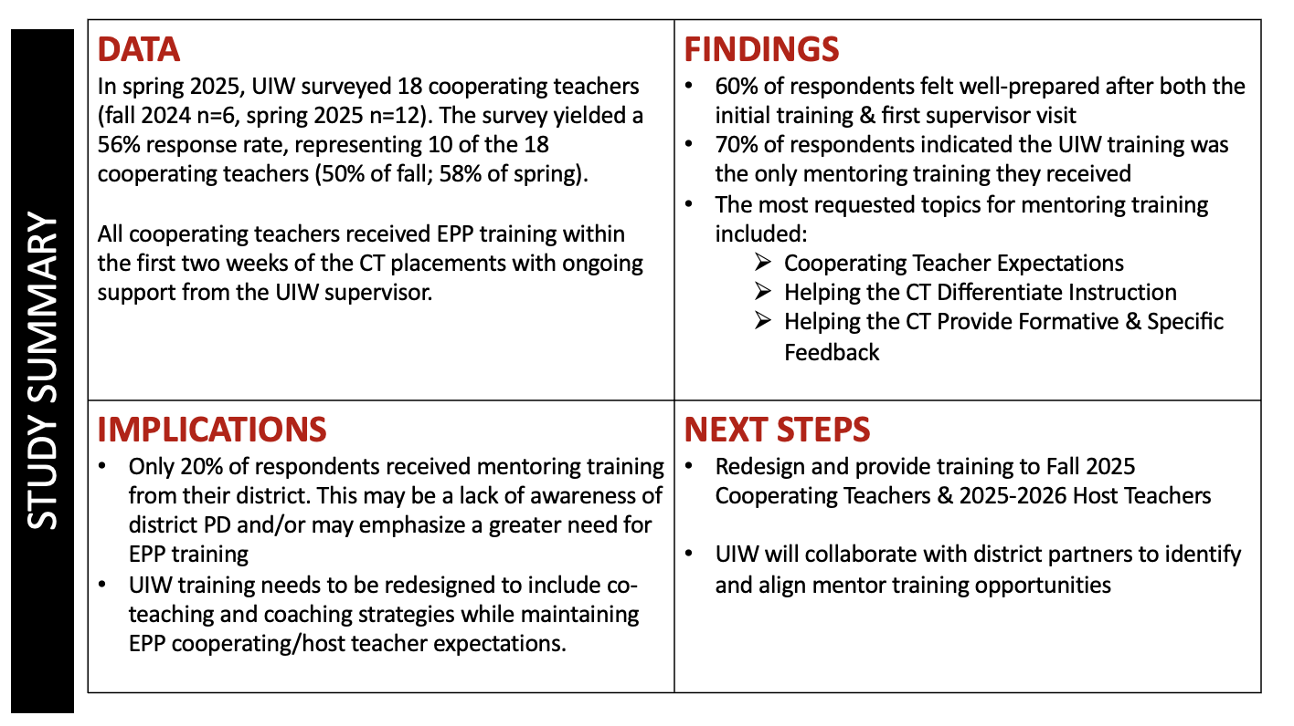

Slide 5
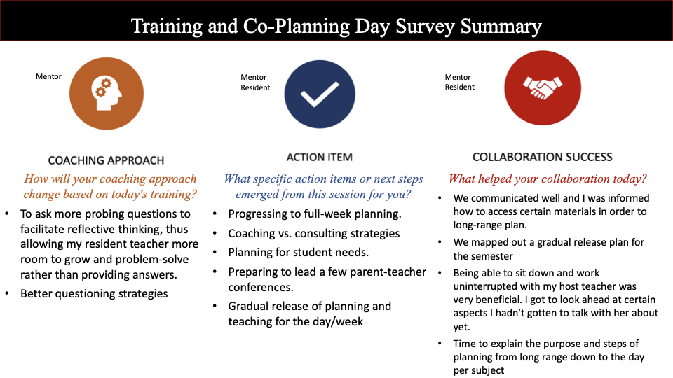

Slide 6
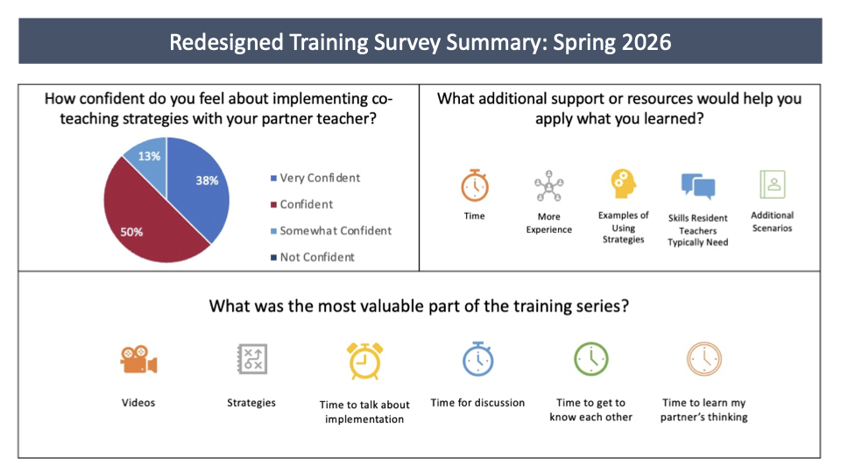

Slide 7


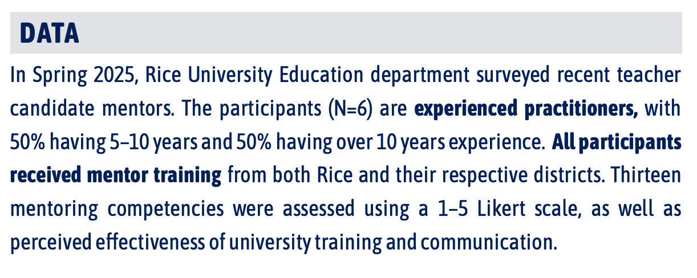

Slide 8


IMPLICATIONS
FINDINGS
Mentor skills are interconnected High correlations between engagement, strategies, expectations, and behavior suggest training in one area can boost others. Targeted training = broader confidence gains
Preparedness is weakly connected Mentors’ sense of preparedness (influenced by Rice training) shows little correlation with other skills. Current training may not align with mentor priorities or needs
Support & Initiative need attention These skills showed lower average ratings and weaker ties to other competencies. These areas may lack clear guidance or structure in training
Mentors reported strong confidence in providing emotional support (M = 4.5) but less in helping with student motivation and engagement (M = 3.7; Figure 1). Only one of six felt Rice’s training met their needs. Confidence levels across competencies were strongly interrelated, with many correlations above 0.70 (Figure 2).
NEXT STEPS
ONBOARDING
ENGAGEMENT
SUPPORT
Increase cadence of meet-and-greets and newsletters
Schedule regular check-ins between the entire candidate support team
Develop concise materials based on competency survey results
Establish clear timelines
Clarify roles early and often, focusing on survey findings
Refocus training on role clarity as highlighted by the survey

Slide 9
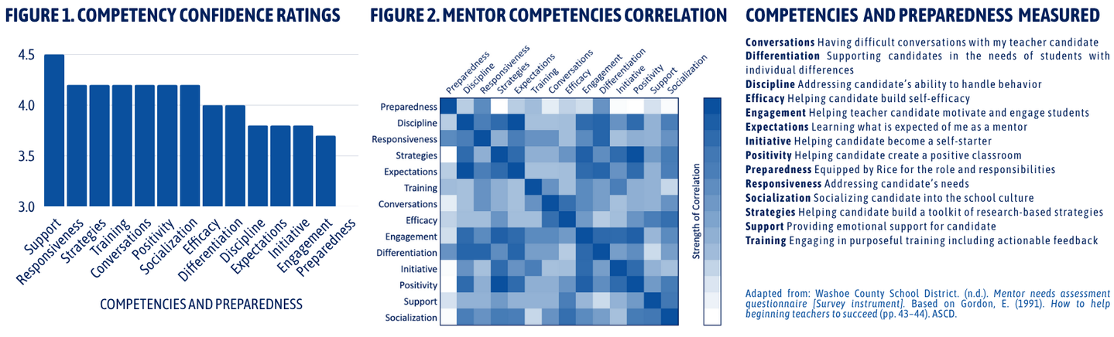


Slide 10

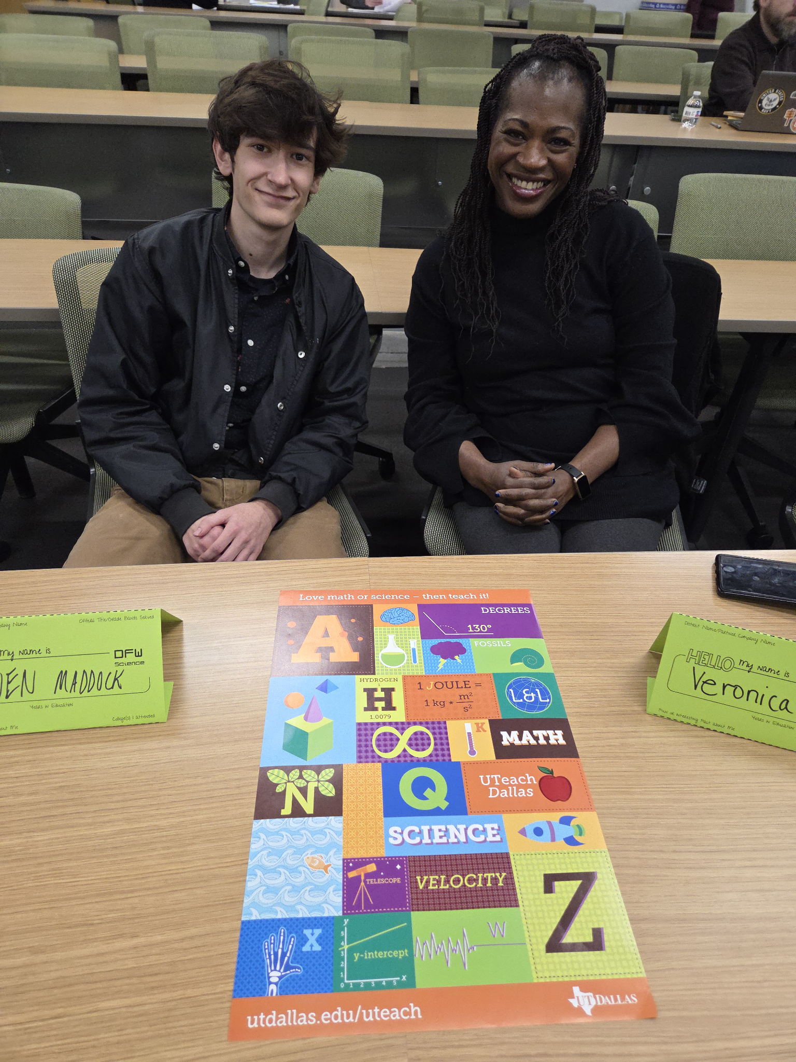
The Big Questions
What are the training needs for our mentor/cooperating teachers?
What are the characteristics of our mentor/cooperating teachers including experience?
What differentiation in training is needed to better serve our mentor/cooperating teachers?
Are partner districts providing mentoring training?
Survey deployed with mentor teachers in December 2025 for Spring 2026 cohort (n=7).

Slide 11
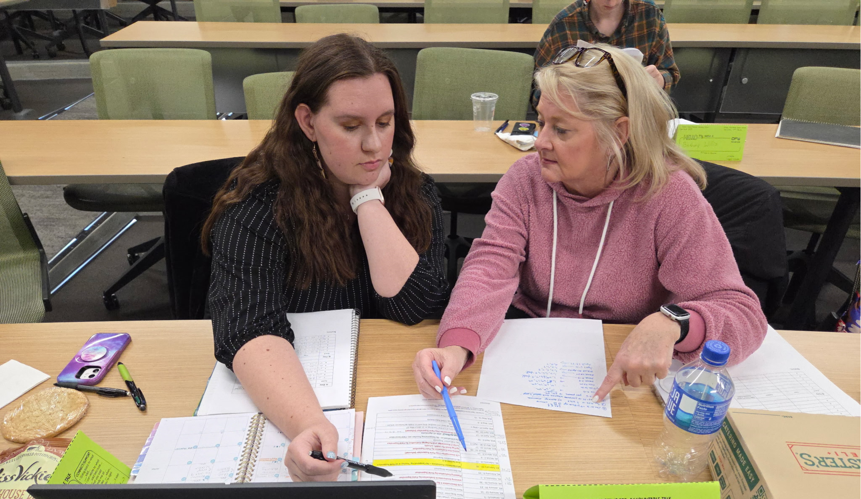
Survey Results
All mentors were experienced teachers with 10–25 years in public schools. More than half (4/7) of were alternatively certified and none were prepared through the UTeach model.
Three were returning UTeach Dallas mentors and three had completed mentor training through their district, in two partner districts with UTeach Dallas. Of these, all agreed or strongly agreed that they had been well prepared as mentors by the program and/or their districts.
Areas of need identified included conducting coaching cycles and co-teaching models.

Slide 12
Programatic Response
Re-imagined mentor training beginning in August 2025
In addition to the co-teaching training that was already in place based on the St. Cloud model, we added material from Student-Centered Coaching: The Moves by DIane Sweeney and Leanna Harris and bought this book for our field supervisors.
Next Steps
Revised the survey to improve clarity
Need to deploy for the next cohort before Fall 2026 (challenges with timing in terms of mentor assignments)
Need to submit IRB
Explore streamlining options for early field experience surveys
Explore options for differentiation, which may include online training or optional professional

Slide 13
Summary
Learned that mentors had more variation in background than initially anticipated
There is a need for differentiated training
How to structure that training is an ongoing challenge in terms of timing and need
Unknowns regarding the changing mentor training landscape (ex. TEA’s mentor training)

